Slide 1
Final Project: IMDB Movie Analysis
BY: Gabriel Ali
Nicholas Dupuis
Max Kofsky
Sarah Laschuk
Cindy Tang

Slide 2
OUTLINE
General Questions of Interest
Motivation
Target Audience
Data Collection
Q1: Top Movies over the years
Q2: Regression
Q3: Correlation
Prototype
Q&A

Slide 3
General Questions of Interest:
“How do the key metrics of Top Movies vary by year?”
“How do the estimated ratings and gross profits vary by genre?”
“Is there a correlation between rating and gross profit?”

Slide 4

Motivation:
By collecting and analyzing a large set of data on the top rated films, our end goal is to provide movie-lovers with an interactive app to help them select new films to watch based on their desired criteria and interests

Slide 5

Target Audience
Our data analysis is intended to assist individuals who spend more time looking for a movie than they do watching them.

Slide 6
Data Collection
RESULTS:
STEP 3
STEP 4
STEP 1
STEP 2
Download and install packages
Tools Used:
Rvest
Dplyr
Stringr
GGplot2
Make a function to scrape data from target IMDB list by CSS selector
URL: https://www.imdb.com/list/ls006266261
Performer cleaning on each scrapped variable to isolate relevant values and strings
Create a loop to paginate the function and scrape all entries
Append together all entries from all pages
Perform final wrangling on the data to prepare it for analysis
Separate genre tags into corresponding dummy variables
Output a data frame with the cleaned data and all appropriate classes assigned to the variables

Slide 7
Q1: How do the key metrics of Top Movies vary by year?
“How has the Average Run Time of movies changed over the years?”
“How have the Average Gross Profits of top movies changed over the years?”
“Which years have produced the Most Top Movies?”
Notes:
Thanks Max!
For our first question we wanted to explore the average run times, gross profits and count of top movies over the years

Slide 8
Q1: analysis of Max/Min and Means
Split up the movie data by release year
Then find the average of each movie's run-time and gross profit
Find a count of top movies produced in a given year
Analyze by max/min over the years
Notes:
To determine how key metrics have changed over the years we conducted an analysis of means
As well as maximum and minimum values in our data. We began by splitting the movies into separate dataframes
Corresponding to their release years.
We then found the average gross profit and run times as well as a count of the movies release each year and
used the max min functions to extract key dates

Slide 9
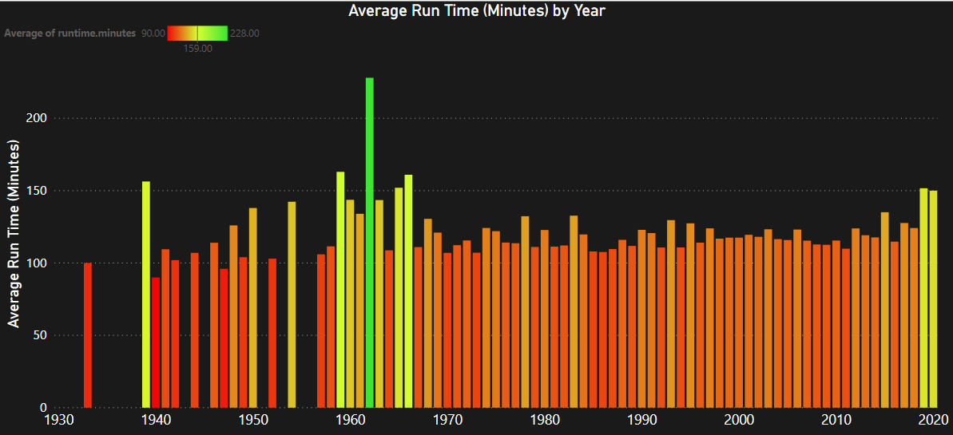
Q1.1: “How has the Average Run Time of movies changed over the years?”
Highest:
1962 at an average run time of 228 minutes
Lowest:
1940 at an average run time of 90
minutes
Notes:
The metric we chose to explore was run time.
Average run times have stayed sturdy over the years.
Movies produced in 1962 had the highest run times averaging at 228 minutes.
Movies produced in 1940 had the lowest run times averaging at 90 minutes.

Slide 10
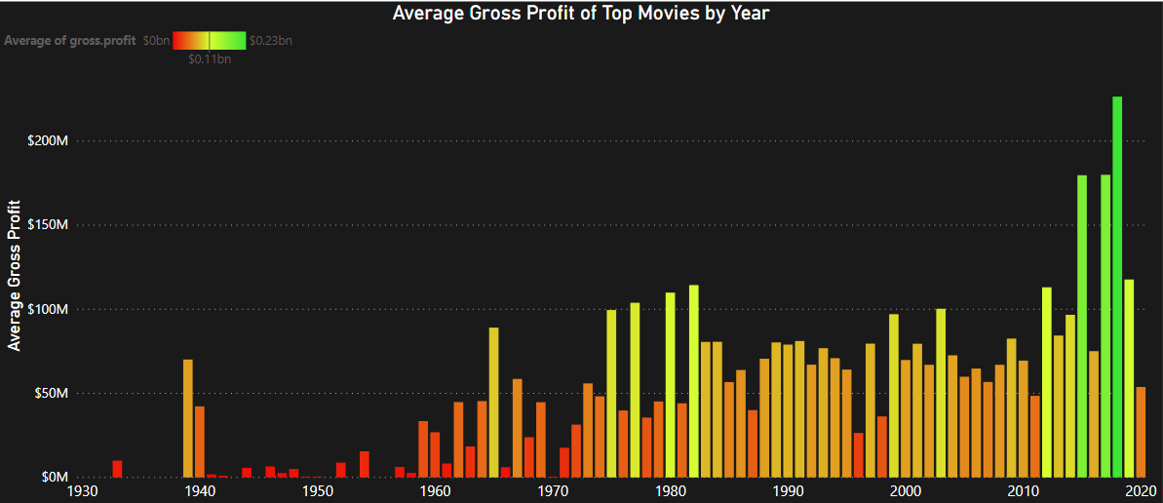
Q1.2: “How have the Average Gross Profits of top movies changed over the years?”
Highest:
2018 gross profits averaged at $226.5M
Lowest:
1950 gross profits averaged at $10K
Notes:
Continuously rising over the years. Early on the gross profits reached an
all time low in 1950 with average gross profits of 10K for movies released that year.
The Movies produced in 2018 achieved the highest gross profits of any year, reaching 226.5M in revenue.
Movies released in following years have reached continuously lower profits.

Slide 11
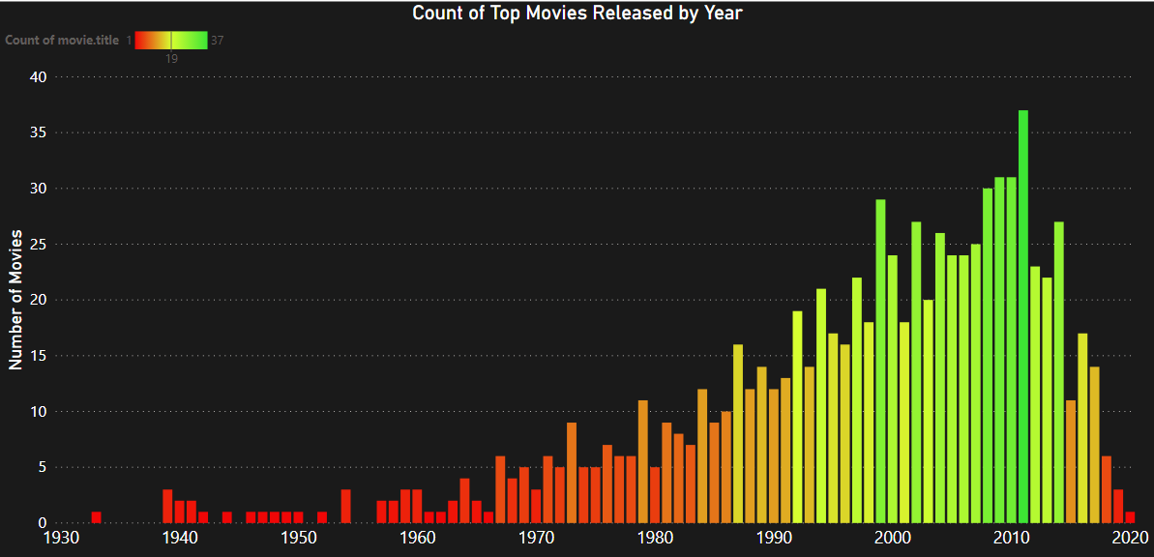
Q1.3: “Which years have produced the Most Top Movies?”
Highest:
37 Top Movies were produced in 2011
Lowest:
1 Top Movie was produced in 1933
Notes:
Our next metric we decided to explore was which years produced the most top movies
Early on in 1933 only one top movie was produced and that number had continuously increased over the years
Peaking in 2018 which saw 37 top movies produced before beginning a steady decline .
Now passing it on to Gabriel for his regression analysis.

Slide 12
Q2: How do the estimated ratings and gross profits vary by genre?
"How does estimated Gross Profit vary with the inclusion of different genres?"
“What about the estimated IMDB Score?”
Notes:
Thanks, Sarah!
For Question 2, we wanted to determine how the estimates for the key metrics changed across all of the film genres.
More specifically, how did the estimated gross profit varied with in the inclusion of certain genres?
And also how did the estimated IMDB rating changed relative to certain genres

Slide 13
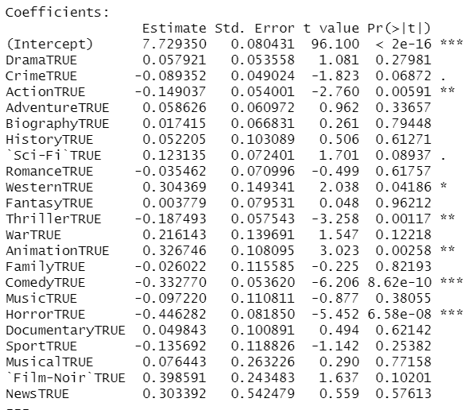
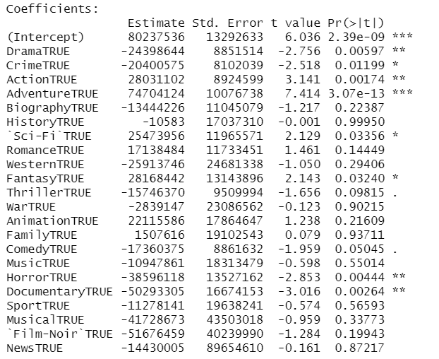
Q2: Regression Analysis
Rating Output
1. Regress Rating to Genre and Summarize
2. Regress Gross Profit to Genre and Summarize
How do we interpret all of this?
Revenue Output
Notes:
To determine this, we utilized regression analysis functions in R.
Regressing the IMDB user score relative to the genre
And regressing the gross profit relative to the genre
Later summarizing our findings to then be fit into a visualization

Slide 14
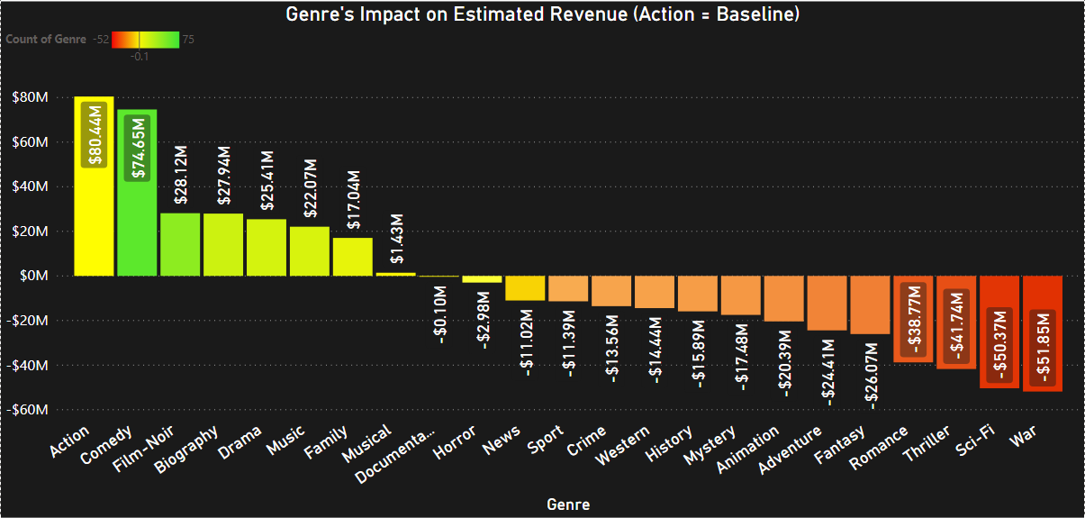

Q2.1: "How does estimated Gross Profit vary with the inclusion of different genres?"
Revenues
COMEDY
+$74.65M
ACTION
+/- $80.44M
WAR
-$51.85M
Notes:
So if you look in this visualization:
We can see that action films (baseline/benchmark) have the highest but for analytical purposes we'll consider it the baseline
Following Action, Comedy has the highest impact financially, then Film Noir, Biographies, Dramas, and so on
Interestingly enough though, War movies (included within the dataset) had the least financial impact of all the genre
Followed by Sci-fi, Thrillers, Romance, Fantasy, Adventure, Animation, Mystery, History, Westerns, Crimes, Sports, News, Horror and finally, Docs
Which mean that the average Comedy film is more likely to be a box office hit than the average war films

Slide 15
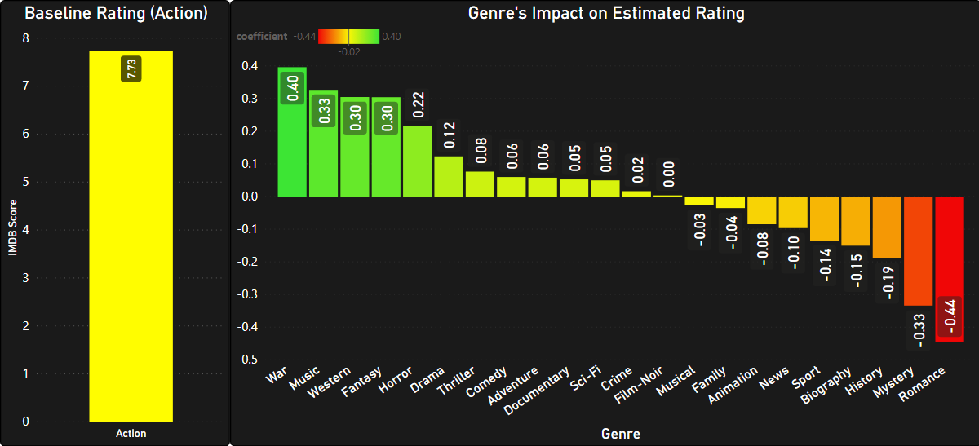
Q2.2: "HOW DOES ESTIMATED IMDB Score VARY WITH THE INCLUSION OF DIFFERENT GENRES?"
Ratings
WAR
+ 0.40
ACTION
+/- 7.73
ROMANCE
- 0.44
Notes:
In this visualization, again using Action as the baseline, you'll see that movie genre with the highest impact on IMDB scores, is War films
Followed Musicals, Westerns, Fantasy, Horror, Dramas, Thrillers, Comedy, Adventure, Documentary, Sci-fis and so on
In contrast to Romance films which have the least impact on ratings

Slide 16
Q3: correlation of ratings and gross profit
"Is there a correlation between the gross profit and the ratings?"

Slide 17
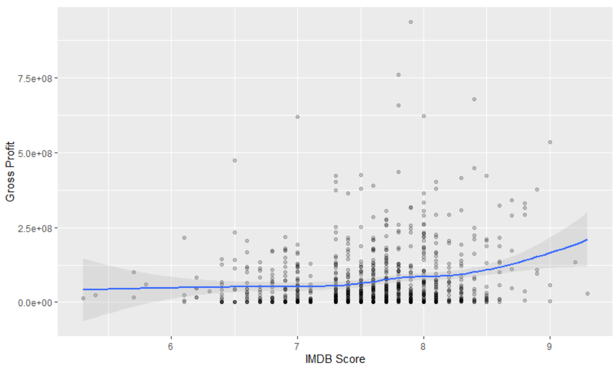
Q3: Correlation Analysis
1.Compute correlation between the IMDB scores & gross profit
Correlation =
0.1689602
What does this mean?

Slide 18
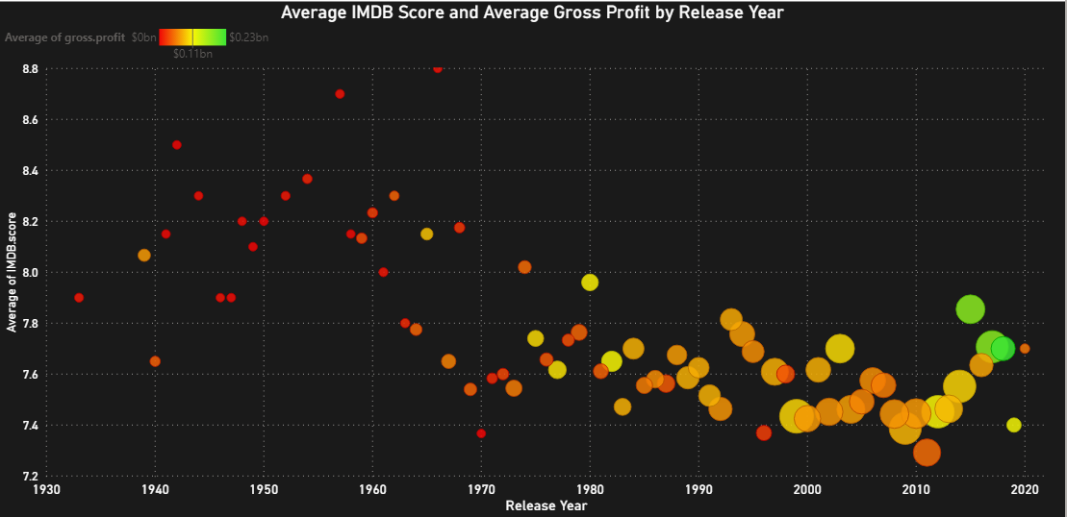

Slide 19
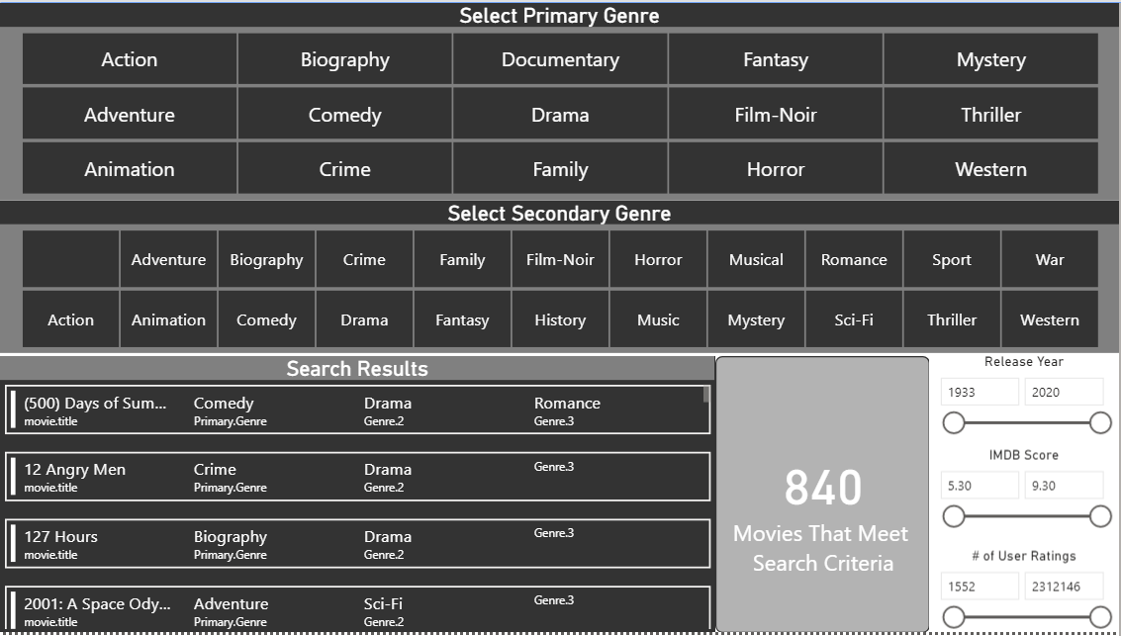
Dashboard Prototype
INTERACTIVE MOVIE SELECTION DASHBOARD PROTOTYPE

Slide 20


Does Anybody Have Any Questions?
Thank you for your time and attention

